Slide 1


BHARATI VIDYAPEETH’S COLLEGE OF ENGINEERING
LAVALE, PUNE–412115.
DEPARTMENT OF COMPUTER ENGINEERING
ACADEMIC YEAR: 2024 -2025
Title: Multi-Modal Deepfake Detection: Techniques and Integration for Enhanced Multimedia Security.
PROJECT GUIDE:
PROF. YOGESH KADAM.
GROUP ID: 10

Slide 2




PROBLEM
STATEMENT
Deepfake technology enables the creation of convincing synthetic media across images, videos, and audio, facilitating misinformation and fraud. Current detection methods are format-specific and limited in scope. A comprehensive cross-modal detection system is needed to effectively identify and mitigate deepfakes across all media formats.

Slide 3

MEET OUR TEAM
01 Akshay Redekar - 35
02 Mansi Alhat - 56
03 Prachi Nikalje -57
04 Pradnya Vavale - 58

Slide 4

AGENDA
1.Introduction
2.Motivation
3.Objective
4.Literature review
5.Research gaps
6.Feasibility and scope of the project
7.Requirement Analysis
8.Methodology
9.Proposed Pipeline
10.Data Flow Diagram
11.Activity diagram
12.Implementation
13.Conclusion
14.References

Slide 5


INTRODUCTION
Deepfakes are AI-generated synthetic media that appear authentic but are artificially created or manipulated.
Created using advanced machine learning techniques like GANs to produce convincing digital forgeries.
Offers benefits in entertainment and education, while posing risks for misinformation, fraud, and identity theft.
Growing accessibility creates urgent challenges for digital trust and information integrity.

Slide 6
MOTIVATION
Protecting privacy and security in the digital age by identifying manipulated media.
Preventing the spread of harmful deepfakes that could cause emotional distress or damage reputations.
Maintaining trust in digital communication and preventing misuse of AI technology.

Slide 7

LITERATURE REVIEW
Focus Area | Key Findings | Year
Top Performance | Multimodal frameworks achieved highest accuracy (94%) | 2024
Hybrid Models | CNN+sequential models (InceptionResNetV2+LSTM: 91.48%) | 2024
Video Detection | Optical flow with CNN-LSTM hybrids reached 91.21% accuracy | 2024
Audio Detection | Mel-spectrogram analysis and VGGish with Attention Block (0.07% EER) | 2024
Spatial-Temporal | Integrated CNN+GRU methodology for improved detection | 2022
Overall Trend | Evolution from single-modal to integrated multimodal approaches | 2022-2024

Slide 8

LITERATURE REVIEW

Slide 9
RESEARCH GAPS
Many current methods struggle to detect with highly realistic deepfakes created using advanced GANs.
Existing models demand high computational resources; new approaches focus on efficient architectures and optimization techniques
Need for Explainable AI (XAI) to improve user trust and detection effectiveness
Existing deepfake detection models face challenges in real-time processing

Slide 10

SCOPE OF THE PROJECT
Media & Personal Protection
Security Systems Integration
Platform Implementation
Verifying authenticity of media content
Protecting individuals from identity fraud and reputation damage
Financial security enhancements
Automating detection of manipulated content in critical systems
Social media identitiy
authentication
Identity verification fraud prevention mechanisms

Slide 11

DATASET USED
AUDIO DATASETS:
ASVspoof (spoofed audio), WaveFake (deepfake samples), The Fake-or-Real (FoR) Dataset (synthetic speech), LJSpeech (speech recordings)
VISUAL DATASETS:
FakeAVCeleb (video), Flickr DeepFake (images/videos), 140k-real-and-fake-faces

Slide 12
METHODOLOGY
Audio Deepfake Detection: Wav2Vec2 with Attention Mechanism
Wav2Vec2 is a transformer-based model designed to capture temporal and spectral dependencies in audio data, making it effective for speech analysis.
Attention Mechanism helps the model focus on the most relevant parts of the audio, improving detection accuracy.
Process:
✓ Convert audio to MFCC features & Mel Spectrograms.
✓ Pass features through Wav2Vec2 layers to analyze speech patterns.
✓ Apply Attention Mechanism to highlight key time frames.
✓ Classify as Real or Fake using a fully connected layer.

Slide 13
METHODOLOGY
Image Deepfake Detection – EfficientNetV2
EfficientNetV2 is a convolutional neural network (CNN) designed for high performance with fewer parameters, ideal for deepfake video detection.
Compound scaling optimizes depth, width, and resolution, boosting efficiency and speed for real-time detection.
Process:
✓ Compound scaling balances depth, width, and resolution for efficient feature extraction.
✓ Optimized architecture reduces computational cost while maintaining robust performance.
✓ Enhanced training with progressive learning adapts to complex deepfake patterns
✓ Fine-tuned layers improve detection of subtle manipulations in images.

Slide 14
IMPLEMENTATION
✓ Data Preparation: Preprocessed images and audio
✓ Trained Image Model: EfficientNetV2
✓ Trained Audio Model: Wav2Vec2
✓ Developed Backend API and Frontend GUI
✓ Integrated Models into a Web Application
✓ Containerized the Application Using Docker

Slide 15












IMPLEMENTATION
TECHNOLOGIES USED

Slide 16
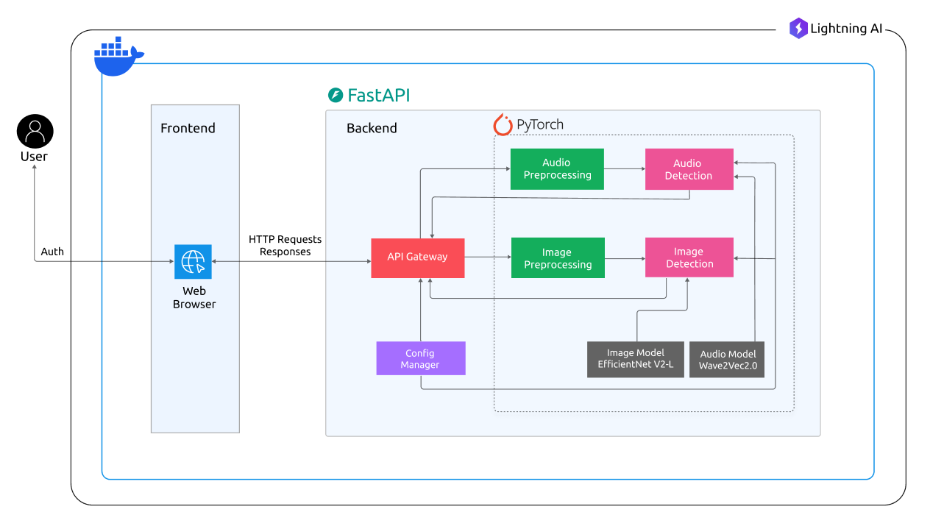
SYSTEM ARCHITECTURE

Slide 17
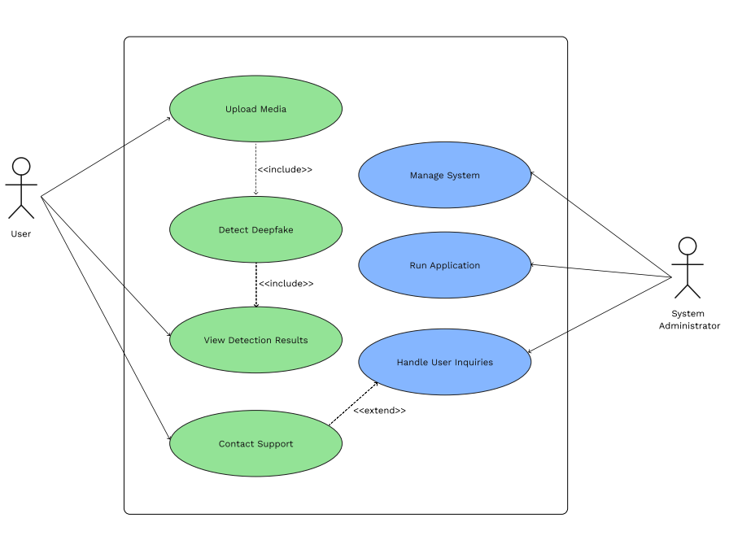
USE CASE DIAGRAM

Slide 18
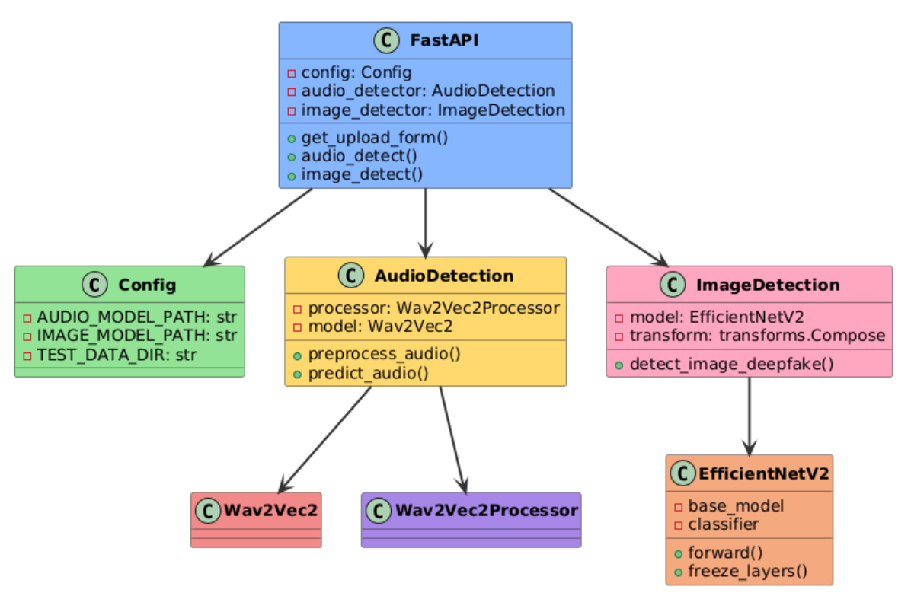
CLASS DIAGRAM

Slide 19
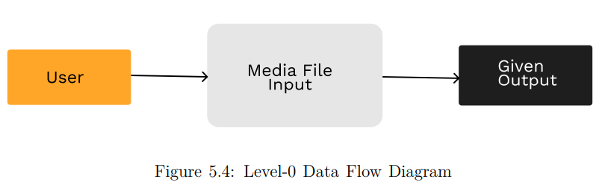
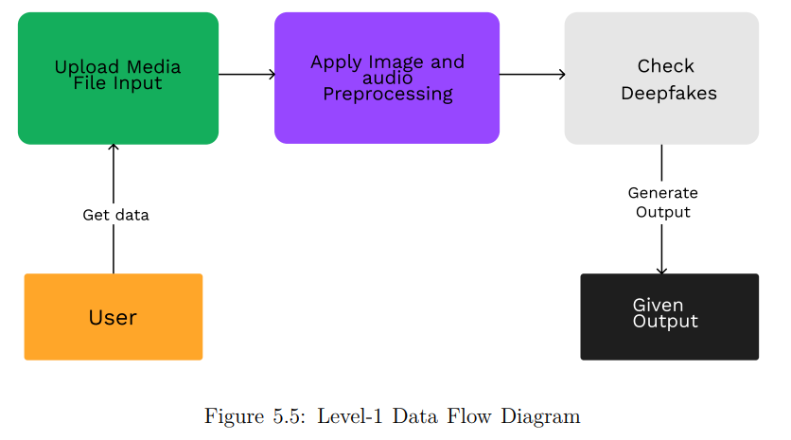
DATA FLOW DIAGRAM
Level 0 DFD
Level 1 DFD

Slide 20


Slide 21
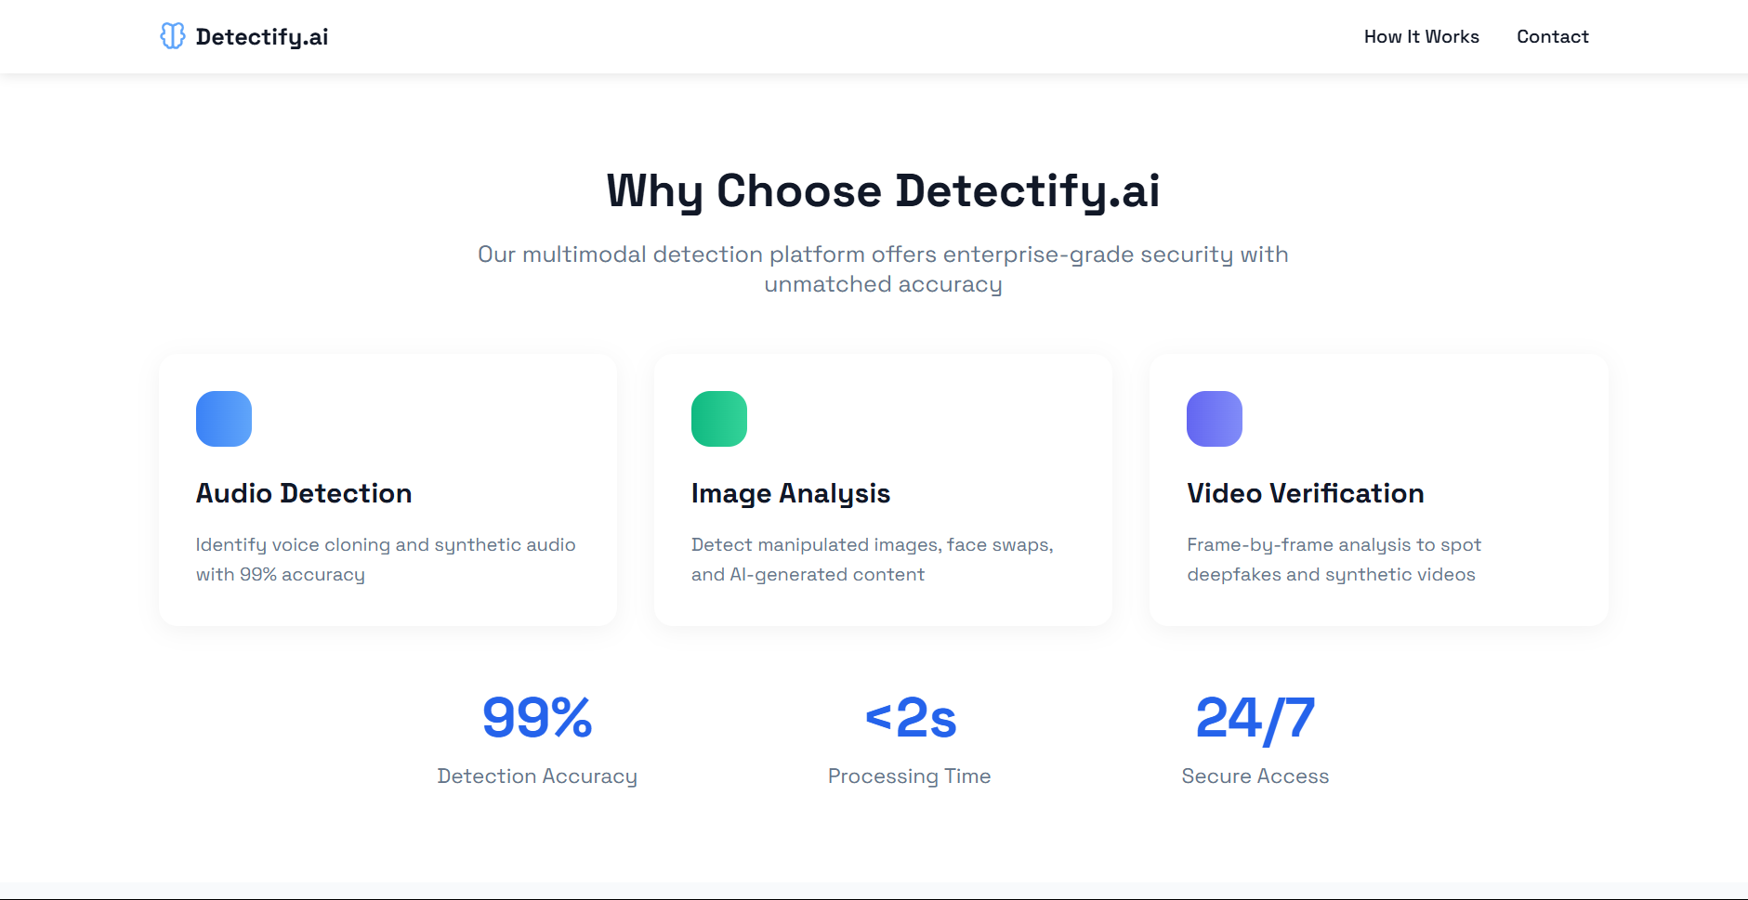

Slide 22
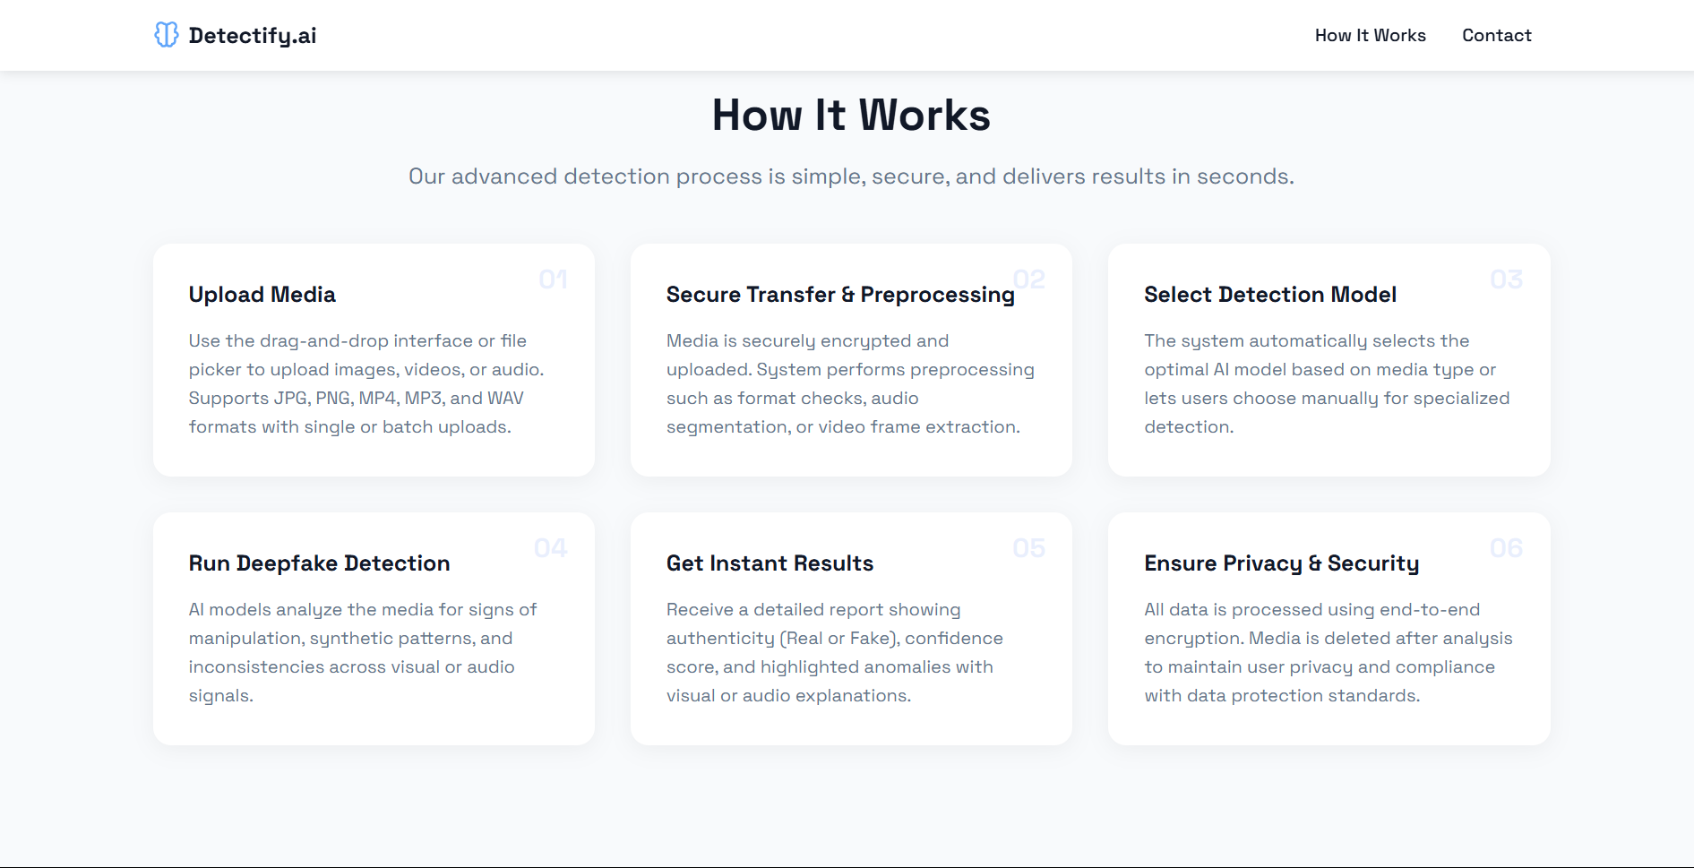

Slide 23
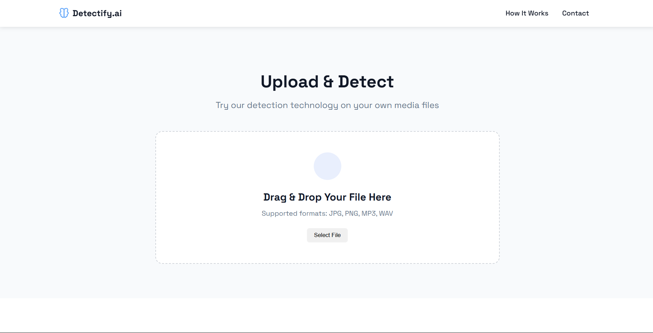

Slide 24
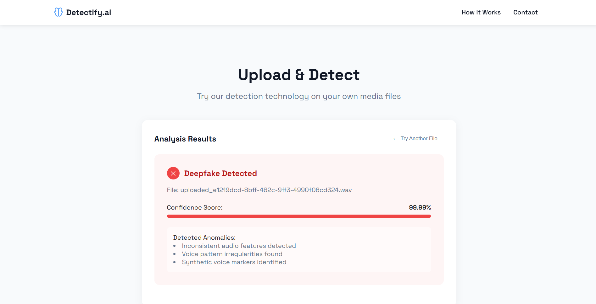

Slide 25
RESEARCH
Comprehensive Review of Image Deepfake Detection Using Neural Architecture Techniques
Audio Deepfake Detection: A Review of Deep Learning Approaches
Rethinking Hallucinations in Foundational LLMs: Mitigation Strategies for Factual and Consistent Text Generation
Multimodal Deepfake Detection: Survey of Fusion Techniques

Slide 26
REFERENCES
Towards Data Science: Articles on multimodal deepfake detection using CNNs and audio-visual fusion techniques, 2024.
Papers with Code: Curated datasets and code for deepfake detection, including FaceForensics++ and ASVspoof benchmarks, 2025.
Analytics Vidhya: Tutorials on building deepfake detection models with image and audio features, 2024.
Kaggle: Notebooks and datasets like DFDC for implementing multimodal deepfake detection, 2025.
Medium: Expert-written posts on audio-visual deepfake detection and multimedia security challenges, 2024.
K. Warren, D. Olszewski, S. Layton, K. Butler, C. Gates, and P. Traynor, "Pitch imperfect: Detecting audio deepfakes through acoustic prosodic analysis," arXiv preprint arXiv:2502.14726, 2025.
K. Gandhi, P. Kulkarni, T. Shah, P. Chaudhari, M. Narvekar, and K. Ghag, "A multimodal framework for deepfake detection," arXiv preprint arXiv:2410.03487, 2024.

Slide 27
CONCLUSION
•The project targets the increasing threat of deepfakes through an effective detection system using deep learning.
•The outcomes will enhance the security and reliability of digital media, protecting individuals and society.
•Ongoing research and collaboration are crucial for keeping up with advancements in deepfake technology and ensuring effective detection.

Slide 28
THANK YOU

